Slide 1
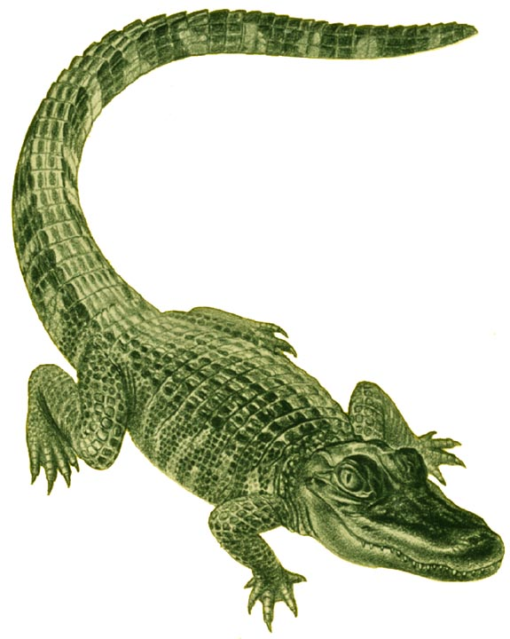
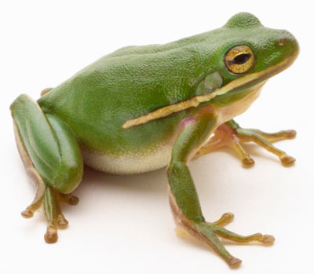
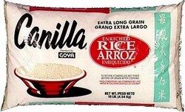
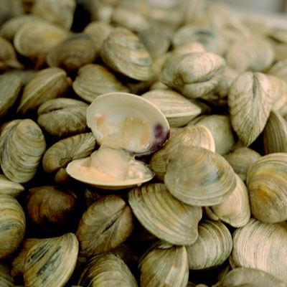
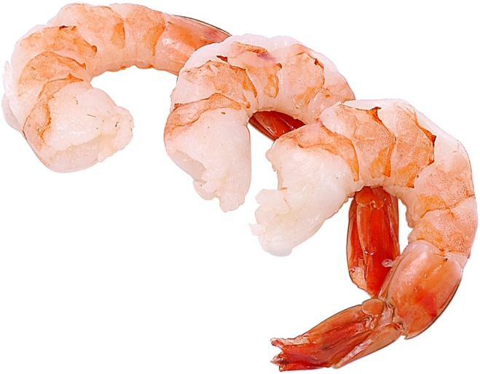
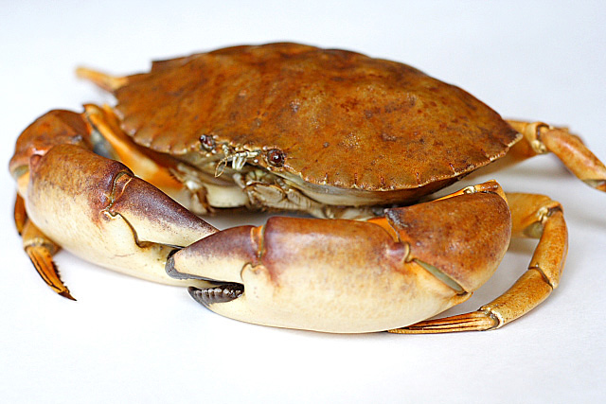

Slide 2
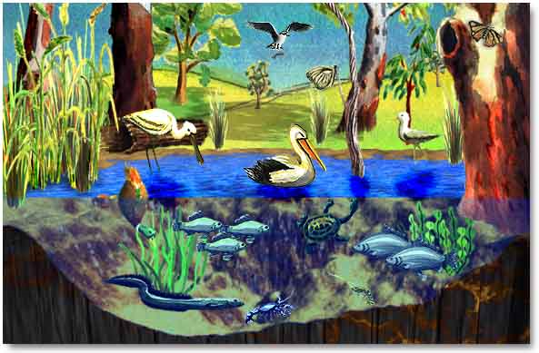
THE WONDERS OF WETLANDS

Slide 3


Slide 4
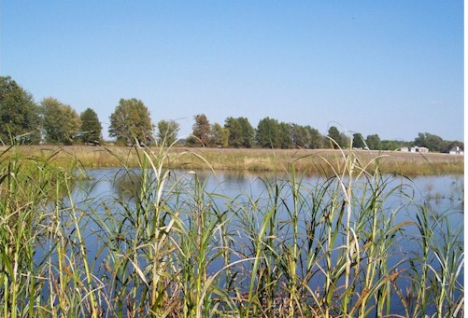
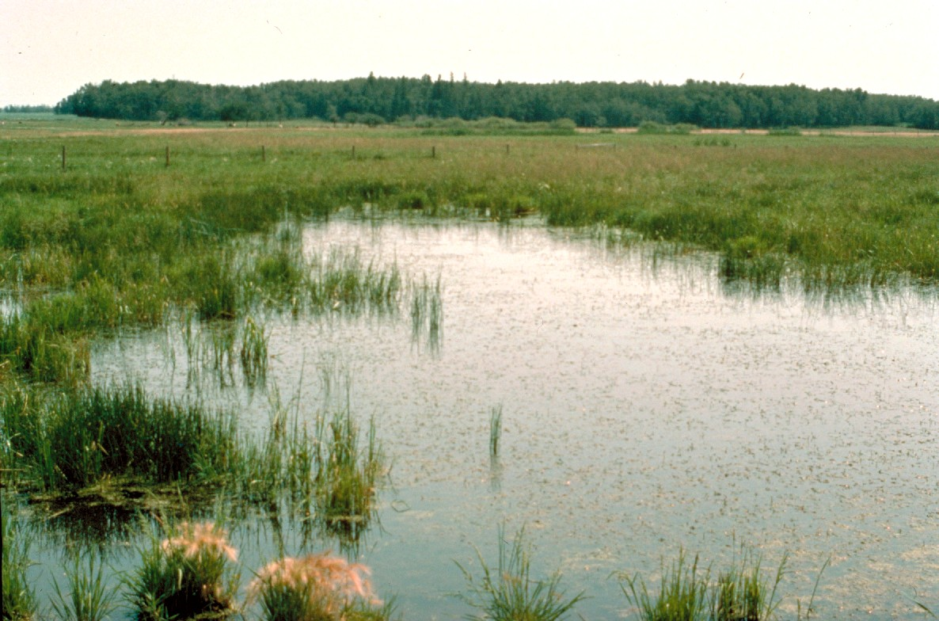
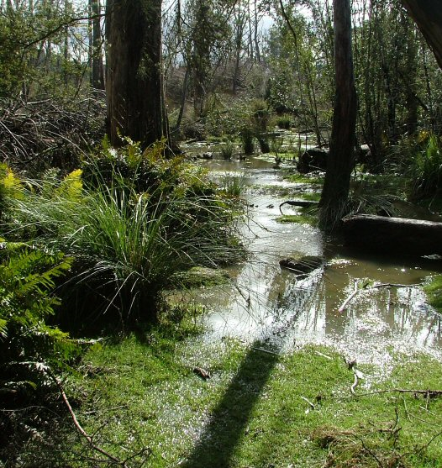
What does “wetland” mean?
- Wet land that contains water, special soil and hydrophytes (water loving plants)

Slide 5
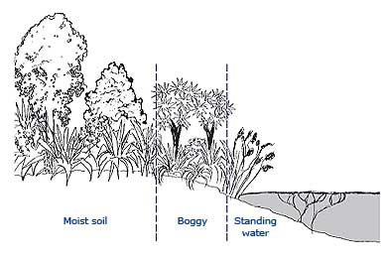
Facts about wetlands…..
Water is present at or near the ground’s surface all or part of the time.
Depth duration and frequency of flooding vary from wetland to wetland.

Slide 6
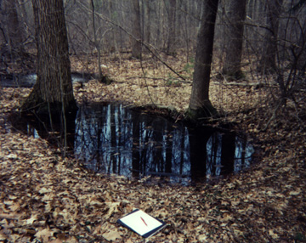
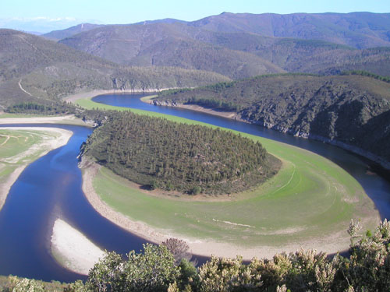
Facts about wetlands…..
Wetlands may be tidal or nontidal
Contain fresh, salt or brackish water
May be any size or shape from a few square feet to hundreds of miles
Vernal pool
River basin

Slide 7
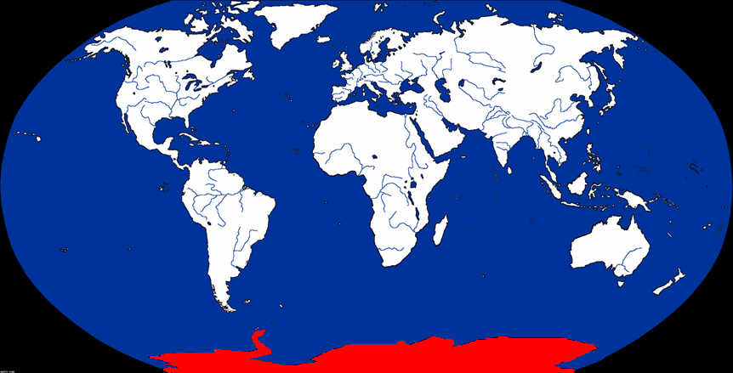
Facts about wetlands…..
They are found on every continent except Antarctica and in every climate.

Slide 8
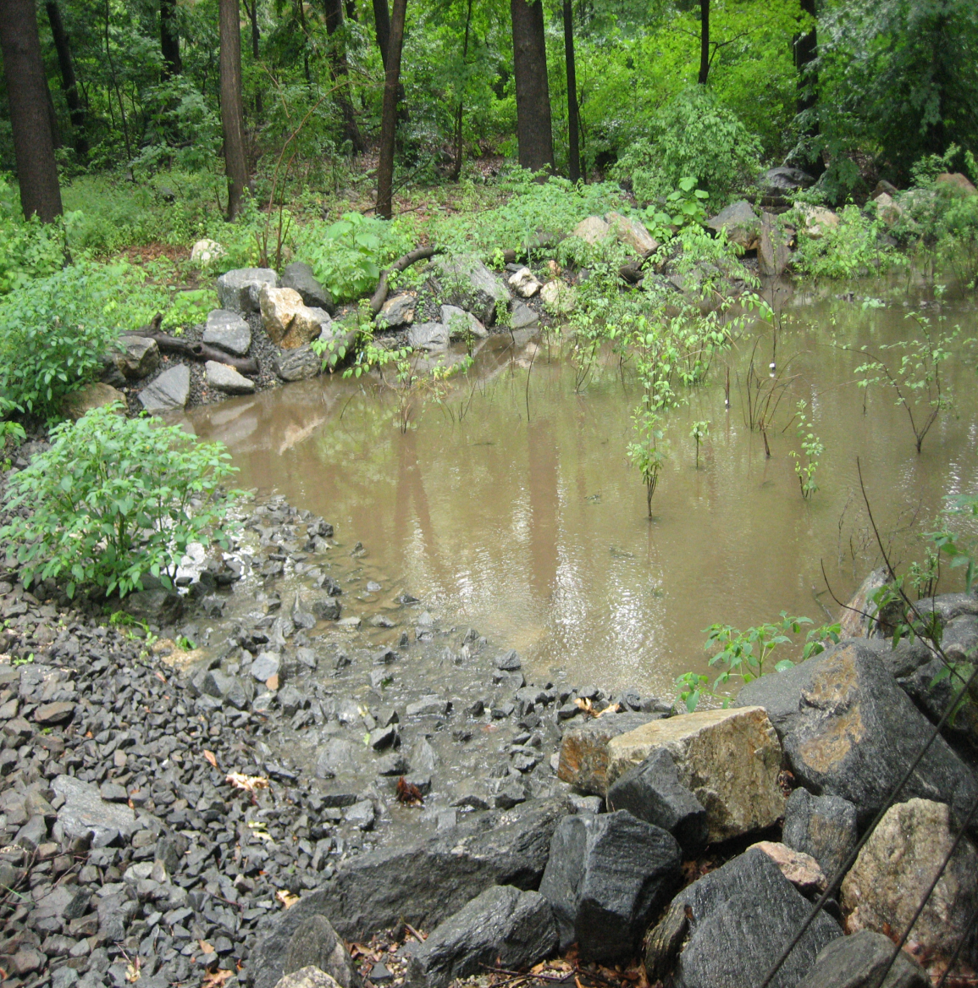
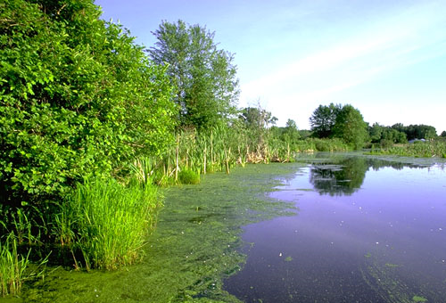
Natural vs. Man-made

Slide 9
Can you find the wetlands?
Ague
Cygnet
Umiak
Dashiki
Swamp
Plat
Bog
Moray
Pocosin
Cravat
Moire
Carr
Whey
Muskeg
Slough
Bower
Pothole
Hoyden
Bursa
Fen
Pompadour
Playa
Espadrille
Mire

Slide 10
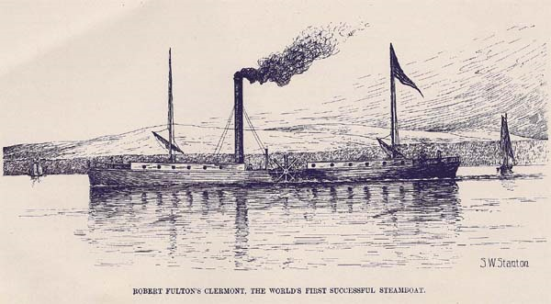
Wetlands around the world……
Colonial America

Slide 11
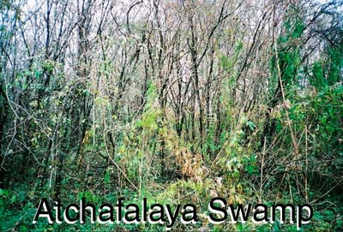
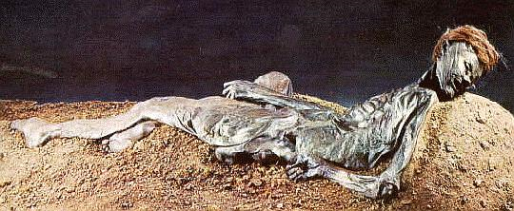
Wetlands around the world……
Cajuns of Louisiana
Archeologists study bog bodies: ancient bodies preserved in peat deposits found in bogs.
Lumber industry

Slide 12
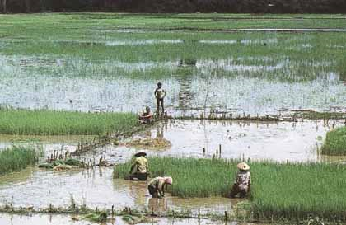
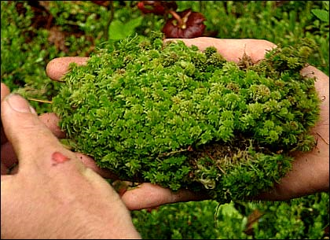
Wetlands around the world…….
U.S. Russia, Ireland, Germany, Belgium, The Netherlands, Denmark
Thailand and other
Asian countries
Rice production
Use peat in gardening, insulation and energy source

Slide 13
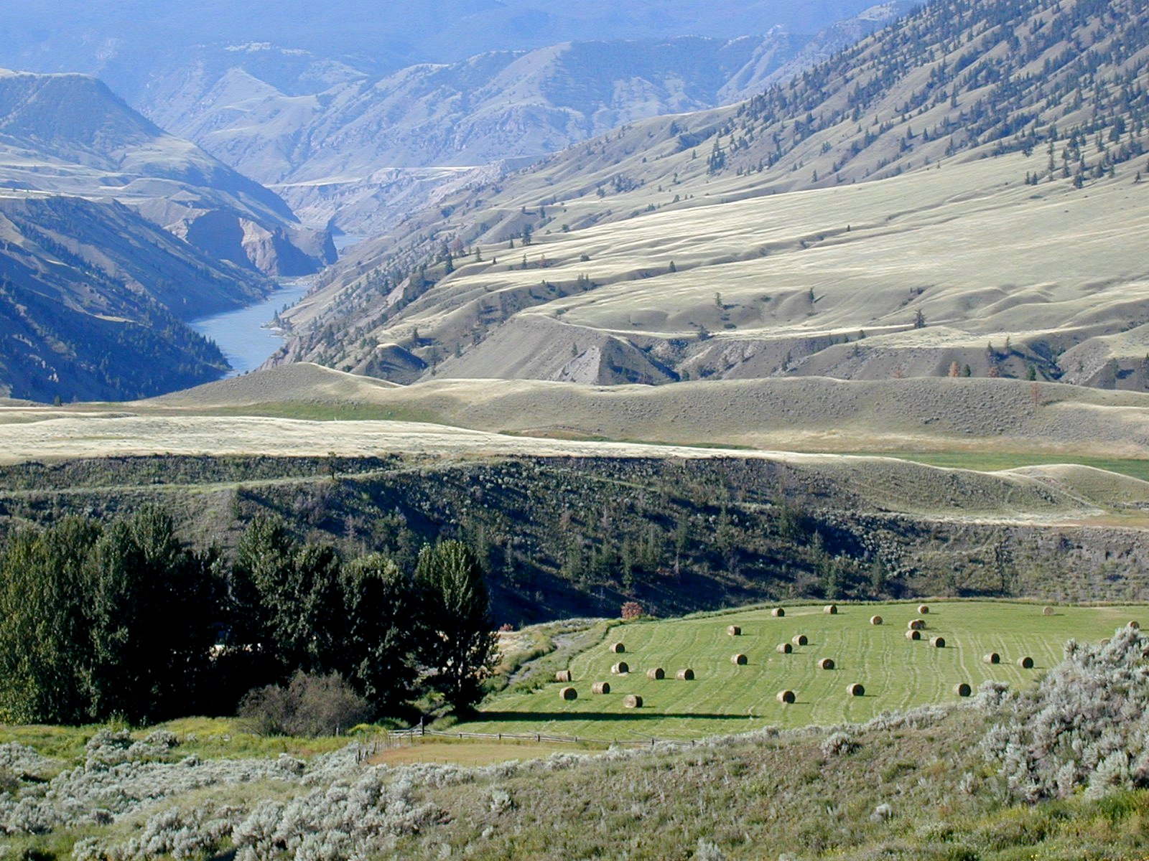
Wetlands around the world…….
Europe,
British Isles,
United States
Livestock grazing and hay production

Slide 14
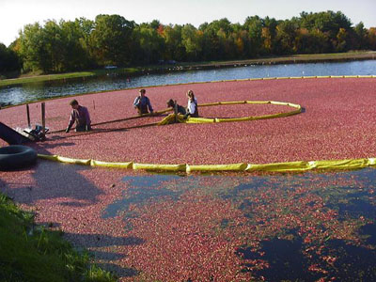
Wetlands around the world……
New Jersey,
Massachusetts,
Wisconsin
Cranberry bogs

