Slide 1
SCIENCE
And the end of the lab reports
AIM: learn how to complete the lab report.

Slide 2
Lab Reports
For the final report you will have
One cover page
One completed report with all sections
Introduction
Methods
Results
Discussion/Conclusion
At least 2 properly formatted sources

Slide 3
Cover Page
Title
Your name
Your school
Date
Teacher’s name
Add in a picture or use different fonts to make it creative!

Slide 4
Report Body
Make sure you have all your sections, separated with section headings.
Font should be simple
Times New Roman
10 – 12 point font (no larger!)
Only section headings can be bold or italics.

Slide 5
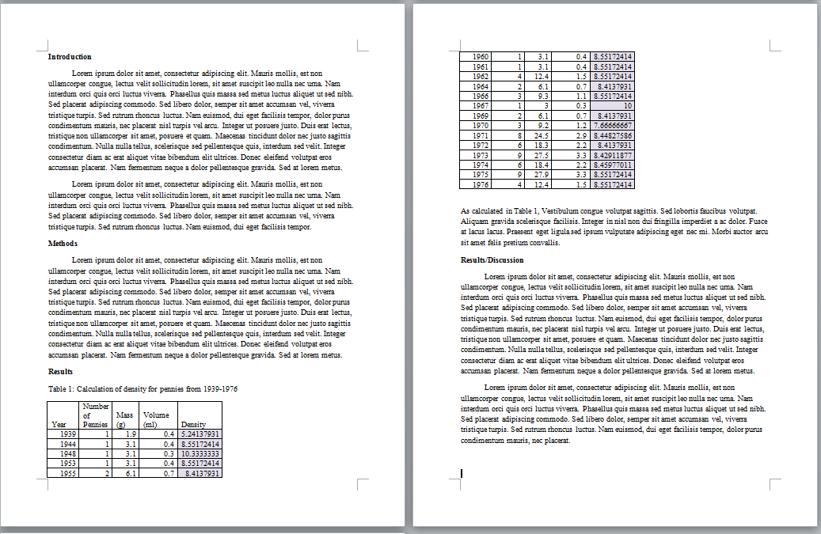
Report Body

Slide 6
Works Cited
You MUST HAVE at least 2 works cited for your lab report.
For a website:
Last Name, First. "Page Title." Website Title. Retrieved Date Accessed, from Web Address
Can also use a citation generator, like Bibme
http://www.bibme.org/

